Slide 1
Chapter 2. Introduction to Data Warehousing

Slide 2

Problem: Heterogeneous Information Sources
“Heterogeneities are everywhere”
Personal
Databases
World
Wide
Web
Scientific Databases
Digital Libraries
Different interfaces
Different data representations
Duplicate and inconsistent information

Slide 3
Problem: Data Management in Large Enterprises
Vertical fragmentation of informational systems (vertical stove pipes)
Sales Planning
Suppliers
Num. Control
Stock Mngmt
Debt Mngmt
Inventory
...
...
...
Sales Administration
Finance
Manufacturing
...

Slide 4
Goal: Unified Access to Data
Integration System
World
Wide
Web
Personal
Databases
Digital Libraries
Scientific Databases
Collects and combines information
Provides integrated view, uniform user interface
Supports sharing

Slide 5
The Warehouse
Clients
Data
Warehouse
Integration System
Metadata
. . .
Extractor/
Monitor
Extractor/
Monitor
Extractor/
Monitor
. . .
Source
Source
Source

Slide 6
What is Data Warehouse?
Defined in many different ways:
A decision support database that is maintained separately from the organization’s operational database
Support information processing by providing a solid platform of consolidated, historical data for analysis.
“A data warehouse is a subject-oriented, integrated, time-variant, and nonvolatile collection of data in support of management’s decision-making process.”—W. H. Inmon
Data warehousing:
The process of constructing and using data warehouses

Slide 7
Data Warehouse—Subject-Oriented
Organized around major subjects, such as customer, product, sales.
Focusing on the modeling and analysis of data for decision makers, not on daily operations or transaction processing.
Provide a simple and concise view around particular subject issues by excluding data that are not useful in the decision support process.

Slide 8
Data Warehouse—Integrated
Constructed by integrating multiple, heterogeneous data sources
relational databases, flat files, on-line transaction records
Data cleaning and data integration techniques are applied.
Ensure consistency in naming conventions, encoding structures, attribute measures, etc. among different data sources
E.g., Hotel price: currency, tax, breakfast covered, etc.
When data is moved to the warehouse, it is converted.

Slide 9
Data Warehouse—Time Variant
The time horizon for the data warehouse is significantly longer than that of operational systems.
Operational database: current value data.
Data warehouse data: provide information from a historical perspective (e.g., past 5-10 years)

Slide 10
Data Warehouse—Non-Volatile
A physically separate store of data transformed from the operational environment.
Operational update of data does not occur in the data warehouse environment.
Does not require transaction processing, recovery, and concurrency control mechanisms
Requires only two operations in data accessing:
initial loading of data and access of data.

Slide 11
Generic Warehouse Architecture
Client
Client
Query & Analysis
Design Phase
Loading
Warehouse
Metadata
Maintenance
Integrator
Optimization
Extractor/
Monitor
Extractor/
Monitor
Extractor/
Monitor
...

Slide 12
Data Warehousing: Two Distinct Issues
(1) How to get information into warehouse
“Data warehousing”
(2) What to do with data once it’s in warehouse
“Warehouse DBMS”
Both rich research areas
Industry has focused on (2)

Slide 13
Data Warehouse & Database
 | Data Warehouse | Database
Purpose | Analysis, Decision making | Day to day use
Support For | OLAP( on-line analytical processing ) | OLTP( on-line transaction processing )
Data model | Multi-dimentional | Rational
Age of data | Current & time series | Current & real time
Data modification | Read/access only | Insert, update, delete
Type of data | Static | Dynamic
Amount of data per transaction | Larger | Smaller
Schema design | Denormalization | normalization

Slide 14
Data Warehousing: Benefit
Provides organizing framework
Gives flexibility for changes and allows simplified maintenance
Speeds up future development by aiding understanding of DW
Communication tool for roles and requirements
Coordinate data marts

Slide 15
Data Warehouse and data Mart
Data warehouse: enterprise based, collects all information about subjects (customers, products, sales, assets, personnel) that span the entire organization
Concerns with decision subjects of the whole enterprise or organization
Requires extensive business modeling (may take years to design and build)
Data mart : department based, Departmental subsets that focus on selected subjects
Specialized single line of business warehouses e.g. within departments or groups of people
Marketing data mart: customer, product, sales

Slide 16
Decision Support System
Information technology to help the knowledge worker (executive, manager, analyst) make faster & better decisions
“What were the sales volumes by region and product category for the last year?”
“How did the share price of comp. manufacturers correlate with quarterly profits over the past 10 years?”
“Which orders should we fill to maximize revenues?”
On-line analytical processing (OLAP) is an element of decision support systems (DSS)

Slide 17
Three-Tier Decision Support Systems
Warehouse database server
Almost always a relational DBMS, rarely flat files
OLAP servers
Relational OLAP (ROLAP): extended relational DBMS that maps operations on multidimensional data to standard relational operators
Multidimensional OLAP (MOLAP): special-purpose server that directly implements multidimensional data and operations
Clients
Query and reporting tools
Analysis tools
Data mining tools

Slide 18
The Complete Decision Support System
Information Sources
Data Warehouse
Server
(Tier 1)
OLAP Servers
(Tier 2)
Clients
(Tier 3)
e.g., MOLAP
Semistructured
Sources
Analysis
Data
Warehouse
serve
extract
transform
load
refresh
etc.
Query/Reporting
serve
e.g., ROLAP
Operational
DB’s
serve
Data Mining
Data Marts

Slide 19
Approaches to OLAP Servers
Relational DBMS as Warehouse Servers
Two possibilities for OLAP servers
(1) Relational OLAP (ROLAP)
Relational and specialized relational DBMS to store and manage warehouse data
OLAP middleware to support missing pieces
have greater scalability
(2) Multidimensional OLAP (MOLAP)
Array-based storage structures
Direct access to array data structures
Fast indexing to pre-computed summarized data
(3) Hybrid OLAP (HOLAP) server
Combine both ROLAP and MOLAP
E.g. Microsoft SQL Server 2000

Slide 20
Data Preprocessing
Real world data : Noisy, missing and inconsistent (why??)
Low quality data => Low quality mining result
Data Cleaning
Data integration
Data transformations
Data reduction

Slide 21
Data Cleaning
Missing values
No record value for several attributes such as income
How can fill missing data?
E.g. manually, fill with mean, fill with probable
Noisy Data
containing errors, or outlier values
How can smooth data ?
E.g. Binning, regression, clustering

Slide 22
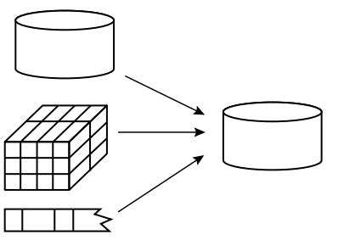
Data Integration
Combines data from multiple sources(e.g. databases, data cubes or flat files) into data warehouse

Slide 23
Data Transformation
Data transforms into appropriate form for mining
Some of the methods:
Smoothing: remove noise
Aggregation : summary or aggregation operations are applied to the data.
Generation : low-level =>high level concepts e.g. age => youth, middle-aged, senior
Normalization : attribute data are scaled into specified range such as -1.0 to 1.0 or 0.0 to 1.0 (e. g. how??)
Attribute construction : New features are constructed and added from the given set of attributes to help the mining process
E.g.

Slide 24
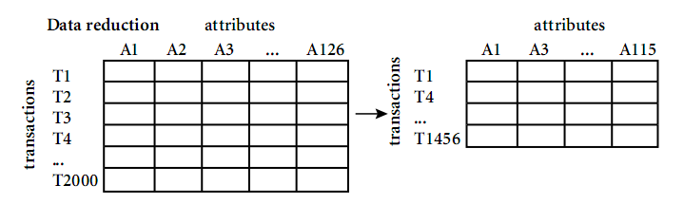
Data Reduction
Goal : Making mining process more efficient with out losing quality
E.g.

Slide 25
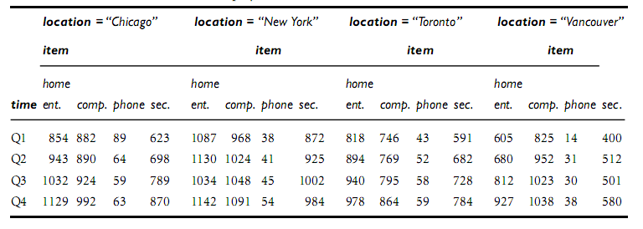
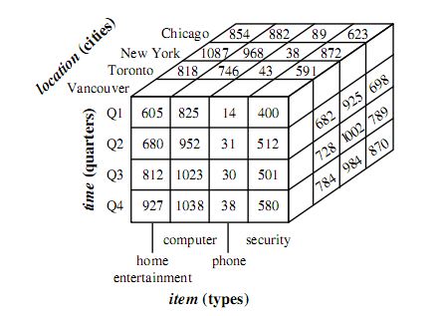
3-D data cube representation from table

Slide 26
Conceptual Modeling of DW
➔Dimensions & Measures
Star schema: A fact table in the middle connected to a set of dimension tables
time
Sales Fact Table
time_key
day
month
quarter
year
item
time_key
item_key
item_name
Brand
supplier_type
item_key
branch_key
branch
location_key
location
branch_key
branch_name
branch_type
units_sold
location_key
street
city
country
dollars_sold
avg_sales
Measures

Slide 27
Conceptual Modeling of DW
Snowflake schema
A refinement of star schema where some dimensional hierarchy is normalized into a set of smaller dimension tables, forming a shape similar to snowflake.

Slide 28
time
item
time_key
day
day_of_the_week
month
quarter
year
item_key
item_name
brand
type
supplier_key
supplier
Sales Fact Table
supplier_key
supplier_type
time_key
item_key
branch_key
branch
location
location_key
branch_key
branch_name
branch_type
location_key
street
city_key
units_sold
dollars_sold
city
avg_sales
city_key
city
state_or_province
country
Measures

Slide 29
Conceptual Modeling of DW
Fact constellations:
Multiple fact tables share dimension tables, viewed as a collection of stars, therefore called galaxy schema or fact constellation

Slide 30
time
time_key
day
day_of_the_week
month
quarter
year
item
Shipping Fact Table
item_key
item_name
brand
type
supplier_type
time_key
Sales Fact Table
item_key
time_key
shipper_key
item_key
branch_key
from_location
branch
location_key
location
to_location
branch_key
branch_name
branch_type
units_sold
location_key
street
city
province_or_state
country
dollars_cost
dollars_sold
units_shipped
avg_sales
shipper
Measures
shipper_key
shipper_name
location_key
shipper_type

Slide 31
OLAP Operations in Multidimensional Data Model
How are concept hierarchies useful in OLAP?
Roll-up :
Drill- down :
Slice and dice :
Pivot (rotate) :

Slide 32
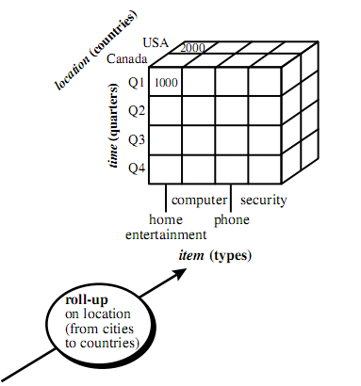
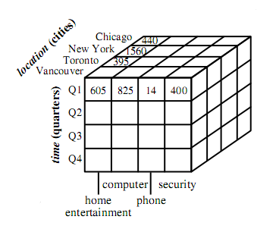
OLAP Operations : roll-up

Slide 33
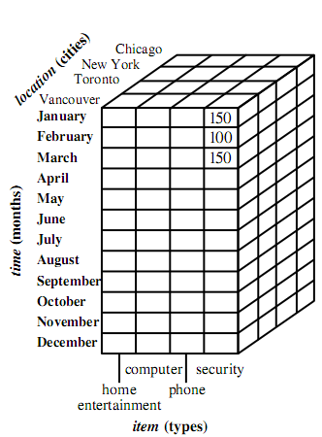
OLAP Operations : drill-down
drill-down on time (from quarters to months)

Slide 34
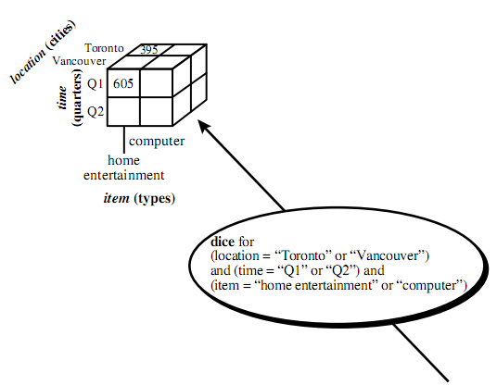
OLAP Operations : dice

Slide 35
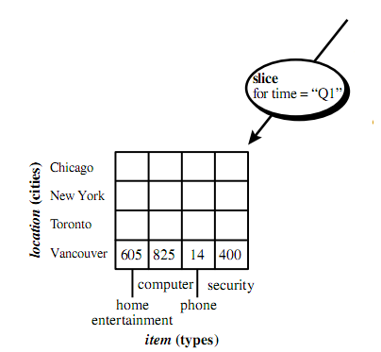
OLAP Operations : slice

Slide 36
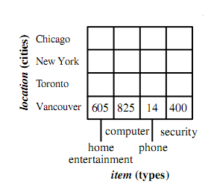
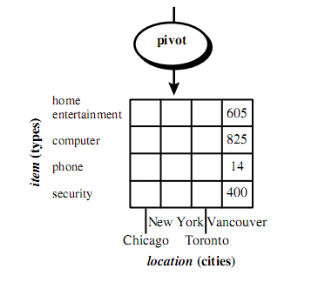
OLAP Operations : pivot

Slide 37
Review
Data mining definitions, applications, issues, classifications
Data warehouse, architecture, benefits, DSS, preprocessing
data cube, OLAP operations
Read Chapter 1, 2, 3
Questions
Next week quiz ☺ ( 10-20 )

